Slide 1
EMPLOYEE DATA ANALYSIS USING EXCEL
STUDENT NAME: HARSHADAA.M
REGISTER NO: 312211715, 7AA95DBB565578DBBD24529F0ABF2834
DEPARTMENT:DEPARTMENT OF COMMERCE-GENERAL
COLLEGE:THIRUTHANGAL NADAR COLLEGE

Slide 2
PROJECT TITLE
EMPLOYEE PERFORMANCE ANALYSIS USING EXCEL

Slide 3
AGENDA
Problem statement
Project overview
End users
Our solution and proposition
Dataset description
Modeling Approach
Result and Discussion
Conclusion

Slide 4
Problem statement
1. High Absenteeism Rates:
Identify patterns and reasons behind frequent absences to understand and address underlying issues.
2. Inconsistent Attendance Patterns:
Determine if attendance fluctuates unpredictably, which can impact productivity and planning.
3. Underutilization of Resources:
Assess whether certain times or departments experience higher absenteeism, leading to imbalanced workload distribution.
4. Employee Engagement:
Analyze attendance trends to gauge employee satisfaction and engagement levels.
5. Predictive Analysis:
Develop forecasts based on historical attendance data to improve scheduling and manage future staffing needs effectively.

Slide 5
PROJECT OVERVIEW
1.Identify Attendance Patterns:
Uncover common attendance trends and irregularities within the workforce.
2.Analyze Root Causes
Explore potential factors contributing to attendance variations.
3.Develop Data-Driven Insights:
Extract meaningful conclusions from the attendance data to inform strategic decisions.
4.Enhance Workforce Engagement:
Promote a culture of positive attendance and employee well-being.

Slide 6
WHO ARE THE END USERS
End users are the individuals or groups who ultimately use or are intended to use a product, service, or system. They are the final consumers or beneficiaries of a product's functionality, often influencing design and development decisions. In various contexts, end users can include:
1. **Consumers**: People who purchase and use products for personal use.
2. **Employees**: Individuals using software or tools in a workplace setting.
3. **Clients**: Organizations or individuals receiving services from providers.
4. **Students**: Learners using educational tools or platforms.
5. **Patients**: Individuals receiving healthcare services or using medical devices.
Understanding the needs and preferences of end users is crucial for creating effective and user-friendly products.

Slide 7
OUR SOLUTION AND ITS VALUE PROPOSITION
Solution Overview:
1.Data Consolidation:
Compile attendance data from various sources (time sheets, biometric systems, etc.) into a structured Excel file. Each employee's attendance details are recorded, such as check-in/check-out times, total hours worked, absenteeism, and overtime.
2. Dynamic Excel Charts:
Use Excel’s charting capabilities to create dynamic visuals such as line graphs, bar charts, heat maps, and pie charts. These charts can show:
- Monthly, weekly, or daily attendance rates.
- Patterns of absenteeism and lateness.
Value Proposition:
1. Improved Decision-Making: Managers and HR personnel can quickly identify attendance issues, such as habitual absenteeism or high turnover rates, and take appropriate action.
2. Enhanced Productivity:
By understanding attendance patterns, organizations can optimize staffing, manage workloads effectively, and identify areas for process improvement.

Slide 8
DATASET DESCRIPTION
Employee ID: Unique identifier for each employee in the organisation
First Name: The first name of the employee.
Gender: A code representing the gender of the employee.
Start date: The employee joined date.
Exit Date:The employee leaves and organisations date.
Employee status:The legal relationship between an employee and their employer .

Slide 9
THE “WOW” IN OUR SOLUTION
1.Dynamic Dashboards
Interactive Pivot Tables: Use PivotTables connected to slicers (filters) for an interactive experience. Users can filter by department, time period, or employee, and the charts update automatically.
Conditional Formatting: Highlight specific trends or deviations directly in the charts, like showing late arrivals or frequent absences in different colors.
2. Creative Use of Chart Types:
Heatmaps: A heatmap can show attendance trends over time, with varying colors representing different attendance levels (e.g., dark colors for high attendance, light colors for low attendance).
Sparkline Charts: Incorporate sparklines in the cells next to employee names to show attendance trends at a glance.
Gantt Charts: Display attendance data over time, showing the exact days employees were present or absent.
3. Custom Graphical Elements:
Custom Icons: Use custom icons or emojis within the chart to represent various types of absences (e.g., sick days, vacation).
Data Bars: Add data bars to cells or charts, visually representing attendance levels within the context of total available working days.

Slide 10
Modelling
1. Data Collection:
Attendance Data: Collect data on employee attendance, such as clock-in/clock-out times, days absent, leave types, and any other relevant information.
Employee Data:
Gather demographic and role-specific data, such as department, job title, seniority, and location.
External Factors:
Consider external factors like public holidays, weather, or major events that might affect attendance.
2. Data Preprocessing:
Cleaning:
Handle missing data, remove duplicates, and correct any inaccuracies.
Feature Engineering:
Create new features like the number of days absent, average attendance time, or frequency of late arrivals.

Slide 11
RESULT
Total 0 0
Total 0 0
Aaden 1808 Mercer 1 0
1808 Total 1 0
Aaden Total 1 0
Aaliyah 3783 Watts 1 0
3783 Total 1 0
Aaliyah Total 1 0
Aarav 2956 Espinoza 1 0
2956 Total 1 0
Aarav Total 1 0
Aaron 1538 Tapia 1 0
1538 Total 1 0
3541 Weber 1 1
3541 Total 1 1
Aaron Total 2 1
Abagail 1502 Banks 1 1
1502 Total 1 1
2114 Moran 1 0
2114 Total 1 0
2713 Villanueva 1 0
2713 Total 1 0

Slide 12
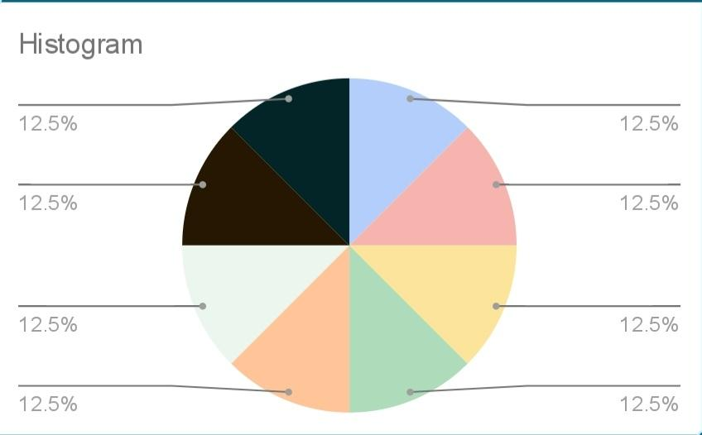

Slide 13
CONCLUSION
In conclusion, visualizing employee attendance trends with Excel charts offers valuable insights into workforce patterns and helps in making informed management decisions. By using various types of charts, such as line graphs for trends, bar charts for comparative analysis, and pie charts for distribution, organizations can easily identify attendance patterns, detect anomalies, and implement strategies to address issues.Excel's flexibility allows for customization and detailed analysis, ensuring that the data is presented in a clear and actionable manner. This approach not only enhances reporting but also supports data-driven decision-making to improve overall productivity and employee engagement.

